Slide 1

Department of
Master of Computer Applications

Slide 2

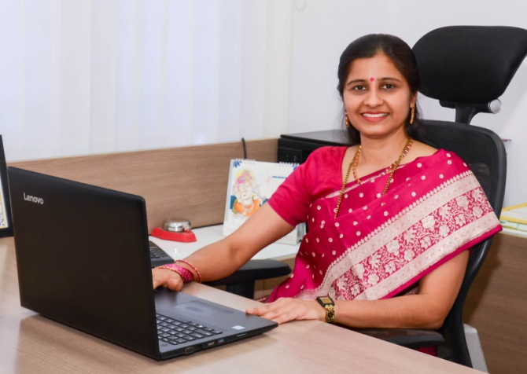
HOD-Profile
Department of Master of Computer Applications (MCA)
Name: Dr. V. Asha, Professor & Head
Qualification: M.Sc., M.Phil., M.Tech., PhD
Area of Specialization : Digital Image Processing and Pattern Recognition
Published more than 40 Research papers International reputed journal & Conferences including IEEE.
Awards: IIT Madras – NPTEL Topper, Received Best Teacher Award in 2009, Best Paper Awards in 2007, 2008, 2009, 2011, 2019, 2020, 2021, 2022
Research Grants: Received a grant of 2 lakhs for conducting FDP from VGST in 2018, Received a grant of 7 lakhs for conducting FDP from AICTE in 2019.
Patent Publications:40+
Guiding PhD Scholars of VTU
BOE Member in VTU
BOS/BOE Member in various Autonomous colleges / Universities
Reviewer in National and International Journals

Slide 3
Department of Master of Computer Applications (MCA)
The Department of Master of Computer Applications was established in 2002.
New Horizon College of Engineering became Autonomous in the year 2015. The first four batches of MCA have graduated under Autonomous Scheme of VTU.
From the academic year 2020-21, the MCA program has become a 2-Year program, approved by AICTE and affiliated by VTU, Belagavi.

Slide 4
PROGRAMS OFFERED
Department of Master of Computer Applications (MCA)
Master of Computer Applications (MCA)
Ph.D in Computer Applications

Slide 5
Department of Master of Computer Applications (MCA)
ELIGIBILITY FOR MCA
Passed BCA / Bachelor degree in Computer Science or equivalent Degree / B.Sc / B.Com /B.A with Mathematics at 10+2 Level or at graduation level
Obtained at least 50% marks (45% marks for reserved category) in the qualifying examination

Slide 6
Department of Master of Computer Applications (MCA)
Vision , Mission & Quality Policy
VISION
To emerge as a department of eminence in the field of Computer Applications in serving the Information Technology Industry and the nation by empowering students with a high degree of technical, managerial and practical competence.
QUALITY POLICY
To provide services of the highest quality both curricular and co-curricular, so that our students can integrate their skills and serve the industry and society equally well at the global level.

Slide 7
Department of Master of Computer Applications (MCA)
Vision , Mission & Quality Policy
MISSION
To strengthen the theoretical, practical and ethical aspects of the learning while inculcating a culture of research, innovation and practical applications amongst faculty and students.
To encourage long-term interactions between the department and the IT Industry through rich involvement of the Industry in the design of the curriculum and its hands-on implementation.
To strengthen and mould students in professional, ethical, social and environmental dimensions by encouraging participation in co-curricular and extracurricular activities.

Slide 8
Department of Master of Computer Applications (MCA)
DEPARTMENT OF MASTER OF COMPUTER APPLICATIONS
MCA DEGREE CURRICULUM – COURSE CREDIT STRUCTURE
BATCH 2024-26 : SEMESTER I TO IV
SEMESTER | CORE | ELECTIVE | MINI PROJECT / PROJECT WORK | SEMINAR | TOTAL CREDITS
I | 20 | 0 | 0 | 0 | 20
II | 12 | 6 | 2 | 0 | 20
III | 6 | 3 | 11 | 0 | 20
IV | 0 | 6 | 12 | 2 | 20
TOTAL | 38 | 15 | 25 | 2 | 80

Slide 9
Department of Master of Computer Applications (MCA)
CURRICULUM STRUCTURE-SEMESTER I
S NO | BOARD/ COURSE | COURSE CODE | COURSE | BOS | CREDIT DISTRIBUTION |  |  |  | OVERALL CREDITS | CONTACT HOURS WEEKLY (THEORY) | MARKS
 |  |  |  |  | L | T | P | S |  |  | CIE | SEE | TOTAL
1 | AS/BSC | 24MATC11 | COMPUTATIONAL MATHEMATICS | MCA | 2 | 1 | 0 | 0 | 3 | 4 | 50 | 50 | 100
2 | MCA/PCC | 24MCA12 | PROBLEM SOLVING WITH C | MCA | 3 | 0 | 0 | 0 | 3 | 3 | 50 | 50 | 100
3 | MCA/PCC | 24MCA13 | OBJECT ORIENTED PROGRAMMING WITH JAVA | MCA | 3 | 0 | 0 | 0 | 3 | 3 | 50 | 50 | 100
4 | MCA/PCC | 24MCA14 | COMPUTER NETWORKS | MCA | 3 | 0 | 0 | 0 | 3 | 3 | 50 | 50 | 100
5 | MCA/IPCC | 24MCA15 | LINUX OPERATING SYSTEM AND SHELL SCRIPTING | MCA | 2 | 0 | 1 | 0 | 3 | 4 | 50 | 50 | 100
6 | MCA/IPCC | 24MCA16 | DATABASE MANAGEMENT SYSTEMS | MCA | 2 | 0 | 1 | 0 | 3 | 4 | 50 | 50 | 100
7 | MCA/PCCL | 24MCAL17 | PROGRAMMING WITH C LAB | MCA | 0 | 0 | 1 | 0 | 1 | 3 | 50 | 50 | 100
8 | MCA/PCCL | 24MCAL18 | OBJECT ORIENTED PROGRAMMING WITH JAVA LAB | MCA | 0 | 0 | 1 | 0 | 1 | 3 | 50 | 50 | 100
9 | AS/NCMC | 24MATC19 | FOUNDATION MATHEMATICS FOR COMPUTER APPLICATIONS * | MCA | - | - | - | - | - | 3 | 50 | - | 50
TOTAL |  |  |  |  | 15 | 1 | 4 | 0 | 20 | 27 | 400 | 400 | 800
Note: BSC – Basic Science Courses, PCC - Professional Core Courses, IPCC - Integrated Professional Core Courses, (No SEE for lab component, only CIE), PCCL - Professional Core Course Lab L – Lecture, T- Tutorial, P-Practical, S - Self Study Research Methodology and IPR Online Course should be mandatorily taken by the students anytime during the program, However the marks will be included in 4th semester. Students have to qualify it for the award of master’s degree *Bridge Course : Non-Credit Mandatory Course 24MATC19- Foundation Mathematics for Computer Applications : Students who have not taken Mathematics at the 10+2 or degree level are required to study and pass this course in the 1st semester. However, this course/ subject will not be considered for vertical progression.

Slide 10
Department of Master of Computer Applications (MCA)
CURRICULUM STRUCTURE- SEMESTER II
S NO | BOARD/ COURSE | COURSE CODE | COURSE | BOS | CREDIT DISTRIBUTION |  |  |  | OVERALL CREDITS | CONTACT HOURS WEEKLY (THEORY) | MARKS
 |  |  |  |  | L | T | P | S |  |  | CIE | SEE | TOTAL
1 | MCA/PCC | 24MCA21 | DATA STRUCTURES | MCA | 3 | 0 | 0 | 0 | 3 | 3 | 50 | 50 | 100
2 | MCA/PCC | 24MCA22 | ADVANCED JAVA | MCA | 3 | 0 | 0 | 0 | 3 | 3 | 50 | 50 | 100
3 | MCA/PCC | 24MCA23 | DESIGN AND ANALYSIS OF ALGORITHMS | MCA | 3 | 0 | 0 | 0 | 3 | 4 | 50 | 50 | 100
4 | MCA/PEC | 24MCA24X | PROFESSIONAL ELECTIVES-1 | MCA | 3 | 0 | 0 | 0 | 3 | 3 | 50 | 50 | 100
5 | MCA/PEC | 24MCA25X | LAB BASED PROFESSIONAL ELECTIVES-1 | MCA | 0 | 1 | 2 | 0 | 3 | 6 | 50 | 50 | 100
6 | MCA/PCCL | 24MCAL26 | DATA STRUCTURES AND ALGORITHMS LAB | MCA | 0 | 0 | 1.5 | 0 | 1.5 | 3 | 50 | 50 | 100
7 | MCA/PCCL | 24MCAL27 | ADVANCED JAVA LAB | MCA | 0 | 0 | 1.5 | 0 | 1.5 | 3 | 50 | 50 | 100
8 | MCA/AEC | 24MCA28 | MINI PROJECT | MCA | 0 | 0 | 0 | 2 | 2 | - | 50 | 50 | 100
TOTAL |  |  |  |  | 12 | 1 | 5 | 2 | 20 | 25 | 400 | 400 | 800
Note: PCC - Professional Core Courses, PEC – Professional Elective Course, PCCL - Professional Core Course Lab, AEC­ Ability Enhancement Course L – Lecture, T- Tutorial, P-Practical, S - Self Study *Research Methodology and IPR Online Course should be mandatorily taken by the students anytime during the program, However the marks will be included in 4th semester. Students have to qualify it for the award of master’s degree. AEC- Students are required to select topics such as ERP, R Programming, Scripting Languages, Web Development Applications, etc. Students must develop a small prototype based on their chosen topic and demonstrate it. A one-week intensive communication skills training program will be scheduled during the vacation.

Slide 11
Department of Master of Computer Applications (MCA)
CURRICULUM STRUCTURE – SEMESTER - II PROFESSIONAL ELECTIVES-1 & 2
PROFESSIONAL ELECTIVES-1
SNO | COURSE CODE | COURSE | BOS |  | CREDIT DISTRIBUTION |  |  | TOTAL
 |  |  |  | L | T | P | S
1 | 24MCA241 | CLOUD COMPUTING | MCA | 3 | 0 | 0 | 0 | 3
2 | 24MCA242 | CYBER SECURITY AND CYBER LAW | MCA | 3 | 0 | 0 | 0 | 3
3 | 24MCA243 | CRYPTOGRAPHY AND NETWORK SECURITY | MCA | 3 | 0 | 0 | 0 | 3
4 | 24MCA244 | ARTIFICIAL INTELLIGENCE | MCA | 3 | 0 | 0 | 0 | 3
5 | 24MCA245 | SOFTWARE ENGINEERING AND TESTING | MCA | 3 | 0 | 0 | 0 | 3
LAB BASED PROFESSIONAL ELECTIVES-1
SNO | COURSE CODE | COURSE | BOS |  | CREDIT DISTRIBUTION |  |  | TOTAL
 |  |  |  | L | T | P | S
1 | 24MCA251 | BUSINESS INTELLIGENCE AND DATA ANALYTICS | MCA | 0 | 1 | 2 | 0 | 3
2 | 24MCA252 | MOBILE APPLICATION DEVELOPMENT | MCA | 0 | 1 | 2 | 0 | 3
3 | 24MCA253 | COMPETITIVE PROGRAMMING WITH PYTHON | MCA | 0 | 1 | 2 | 0 | 3
4 | 24MCA254 | NON RELATIONAL DATABASES (NoSQL) WITH MongoDB | MCA | 0 | 1 | 2 | 0 | 3
5 | 24MCA255 | ASP.NET WITH C# | MCA | 0 | 1 | 2 | 0 | 3

Slide 12
Department of Master of Computer Applications (MCA)
CURRICULUM STRUCTURE – SEMESTER - III
S NO |  | COURSE CODE | COURSE | BOS | CREDIT DISTRIBUTION |  |  |  | OVERALL CREDITS | CONTACT HOURS WEEKLY | MARKS
 |  |  |  |  | L | T | P | S |  |  | CIE | SEE | TOTAL
1 | MCA/PCC | 23MCA31 | MACHINE LEARNING | MCA | 3 | 0 | 0 | 0 | 3 | 3 | 50 | 50 | 100
2 | MCA/PCC | 23MCA32 | FULL STACK DEVELOPMENT | MCA | 3 | 0 | 0 | 0 | 3 | 3 | 50 | 50 | 100
3 | MCA/PEC | 23MCA33X | PROFESSIONAL ELECTIVES - 3 | MCA | 3 | 0 | 0 | 0 | 3 | 3 | 5­0 | 50 | 100
4 | MCA/PEC | 23MCA34X | PROFESSIONAL ELECTIVES – 4 | MCA | 3 | 0 | 0 | 0 | 3 | 3 | 50 | 50 | 100
5 | MCA/PCCL | 23MCAL35 | MACHINE LEARNING LAB USING PYTHON | MCA | 0 | 0 | 1.5 | 0 | 1.5 | 3 | 50 | 50 | 100
6 | MCA/PCCL | 23MCAL36 | FULL STACK LAB | MCA | 0 | 0 | 1.5 | 0 | 1.5 | 3 | 50 | 50 | 100
7 | MCA/SP | 23MCA37 | SOCIETAL PROJECT | MCA | 0 | 0 | 2 | 0 | 2 | - | 100 | - | 100
8 | MCA/INT | 23MCA38 | INTERNSHIP | MCA | 0 | 0 | 6 | 0 | 6 | - | 50 | 50 | 100
9 | MCA/SEM | 23MCA39 | TECHNICAL SEMINAR-1 | MCA | 0 | 0 | 0 | 2 | 2 | - | 50 | 50 | 100
TOTAL |  |  |  |  | 12 | 0 | 11 | 2 | 25 | 18 | 500 | 400 | 900
Note: PCC - Professional Core Courses, PEC – Professional Elective Course (No SEE for lab component only CIE), PCCL – Professional Core Course Lab, SP - Societal Project, INT – Internship (06 weeks Internship to be completed in intervening vacation of Semester II and Semester III), SEM- SEMINAR L – Lecture, T- Tutorial, P-Practical, S - Self Study

Slide 13
Department of Master of Computer Applications (MCA)
CURRICULUM STRUCTURE- SEMESTER - III PROFESSIONAL ELECTIVE 3 &4
PROFESSIONAL ELECTIVES - 3
SNO | COURSE CODE | COURSE | BOS |  | CREDIT DISTRIBUTION |  |  | TOTAL
 |  |  |  | L | T | P | S
1 | 23MCA331 | ADVANCED WEB DESIGNING | MCA | 3 | 0 | 0 | 0 | 3
2 | 23MCA332 | CLOUD COMPUTING | MCA | 3 | 0 | 0 | 0 | 3
3 | 23MCA333 | NON-RELATIONAL DATABASES | MCA | 3 | 0 | 0 | 0 | 3
4 | 23MCA334 | INTERNET OF THINGS | MCA | 3 | 0 | 0 | 0 | 3
5 | 23MCA335 | DEEP LEARNING | MCA | 3 | 0 | 0 | 0 | 3
PROFESSIONAL ELECTIVES – 4
SNO | COURSE CODE | COURSE | BOS |  | CREDIT DISTRIBUTION |  |  | TOTAL
 |  |  |  | L | T | P | S
1 | 23MCA341 | DATA SCIENCE | MCA | 3 | 0 | 0 | 0 | 3
2 | 23MCA342 | COMPUTER VISION | MCA | 3 | 0 | 0 | 0 | 3
3 | 23MCA343 | AUGMENTED REALITY AND VIRTUAL REALITY | MCA | 3 | 0 | 0 | 0 | 3
4 | 23MCA344 | MOBILE APPLICATION DEVELOPMENT | MCA | 3 | 0 | 0 | 0 | 3
5 | 23MCA345 | AGILE SOFTWARE DEVELOPMENT | MCA | 3 | 0 | 0 | 0 | 3

Slide 14
Department of Master of Computer Applications (MCA)
L – Lecture, T- Tutorial, P-Practical, S - Self Study
CURRICULUM STRUCTURE -SEMESTER -IV
S NO |  | COURSE CODE | COURSE | BOS | CREDIT DISTRIBUTION |  |  |  | OVERALL CREDITS | CONTACT HOURS WEEKLY | MARKS
 |  |  |  |  | L | T | P | S |  |  | CIE | SEE | TOTAL
1 | MCA/PEC | 23MCA41X | PROFESSIONAL ELECTIVES – 5 | MCA | 3 | 0 | 0 | 0 | 3 | 3 | 5­0 | 50 | 100
2 | MCA/OEC | 20NHOPXXX | OPEN ELECTIVE COURSE | MCA | 3 | 0 | 0 | 0 | 3 | 3 | 50 | 50 | 100
3 | MCA/SEM | 23MCA42 | TECHNICAL SEMINAR -2 | MCA | 0 | 0 | 0 | 2 | 2 | - | 50 | 50 | 100
4 | MCA/PROJ | 23MCA43 | MAJOR PROJECT | MCA | 0 | 0 | 17 | 0 | 17 | - | 50 | 50 | 100
5 | AUD/AEC | 23AUD44 | ONE CERTIFIED ONLINE COURSE |  | Classes and evaluation procedures are as per the policy of the online course providers. |  |  |  |  |  |  |  | PP
TOTAL |  |  |  |  | 6 | 0 | 17 | 2 | 25 | 6 | 200 | 200 | 400
Note: PEC – Professional Elective Course, OEC-Industrial Open Elective Course, Credit for OEC is 03 (L: T: P:S) can be considered as(3: 0: 0 : 0). The teaching and learning of these Courses will be based on hands-on. The Course Assessment will be based on CIE and SEE in practical mode. These Courses will be offered by Centre of Excellence to students of all the branches. Registration to Industrial open electives shall be documented and monitored on college level SEM- SEMINAR PROJ- Project Work, AUD/AEC – Audit Course / Ability Enhancement Course. L – Lecture, T- Tutorial, P-Practical, S - Self Study

Slide 15
Department of Master of Computer Applications (MCA)
CURRICULUM STRUCTURE-SEMESTER IV - PROFESSIONAL ELECTIVES-5 AND OPEN ELECTIVES
PROFESSIONAL ELECTIVES – 5
SNO | COURSE CODE | COURSE | BOS |  | CREDIT DISTRIBUTION |  |  | TOTAL
 |  |  |  | L | T | P | S
1 | 23MCA411 | PROFESSIONAL ETHICS | MCA | 3 | 0 | 0 | 0 | 3
2 | 23MCA412 | DESIGN THINKING | MCA | 3 | 0 | 0 | 0 | 3
3 | 23MCA413 | ENTREPRENEURSHIP AND INNOVATION MANAGEMENT | MCA | 3 | 0 | 0 | 0 | 3
4 | 23MCA414 | DIGITAL MARKETING | MCA | 3 | 0 | 0 | 0 | 3
5 | 23MCA415 | SOFTWARE PROJECT MANAGEMENT | MCA | 3 | 0 | 0 | 0 | 3
OPEN ELECTIVE COURSES
SNO | COURSE CODE | COURSE | BOS |  | CREDIT DISTRIBUTION |  |  | TOTAL
 |  |  |  | L | T | P | S
1 | 20NHOP601 | BIG DATA ANALYTICS USING HP VERTICA-1 | MCA | 3 | 0 | 0 | 0 | 3
2 | 20NHOP602 | VM WARE VIRTUALISATION ESSENTIALS-1 | MCA | 3 | 0 | 0 | 0 | 3
3 | 20NHOP614 | BLOCKCHAIN | MCA | 3 | 0 | 0 | 0 | 3
4 | 20NHOP728A | DATABASE ADMINISTRATION USING DB2 | MCA | 3 | 0 | 0 | 0 | 3

Slide 16
STRENGTHS & BEST PRACTICES
Department of Master of Computer Applications (MCA)
Dynamic Faculty Team, which will work to break barriers and build sustainable future
Every Semester, the course modules are delivered and reviewed by leading Industrial Experts for making the students industry-ready
Curricular and co-curricular activities are organized, where students can gain current knowledge
Symposiums and conferences are organized where students are encouraged to contribute papers which enhances Research and Development
Club Activities are organized by students for the students to enhance continuous learning
With the help of Strong Alumni Network, Workshops, Guest Lectures, Seminars and Student Development Programmes are conducted at regular intervals
Mini Project in-line with the courses taught
Mandatory MOOC – NPTEL (IIT) online courses for value-addition
Technical Seminar with research perspective.
Research Paper writing & Patent filing

Slide 17
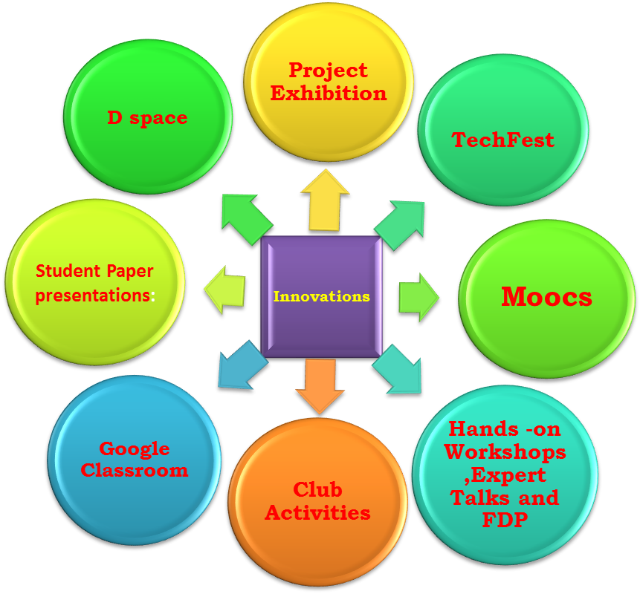
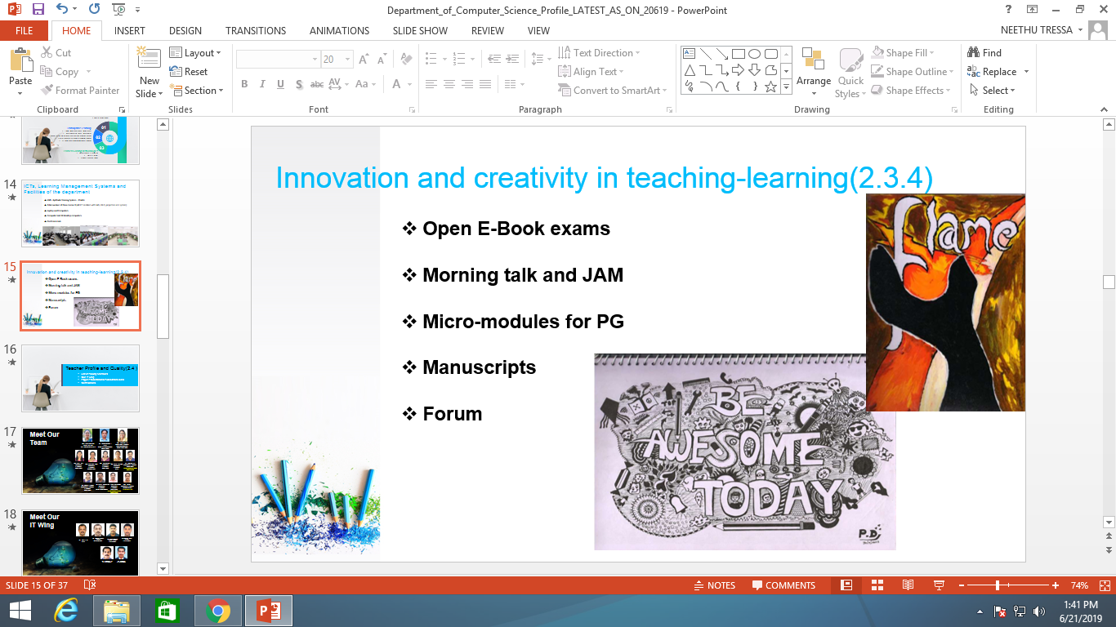
Departmental Best Practices
Department of Master of Computer Applications (MCA)

Slide 18
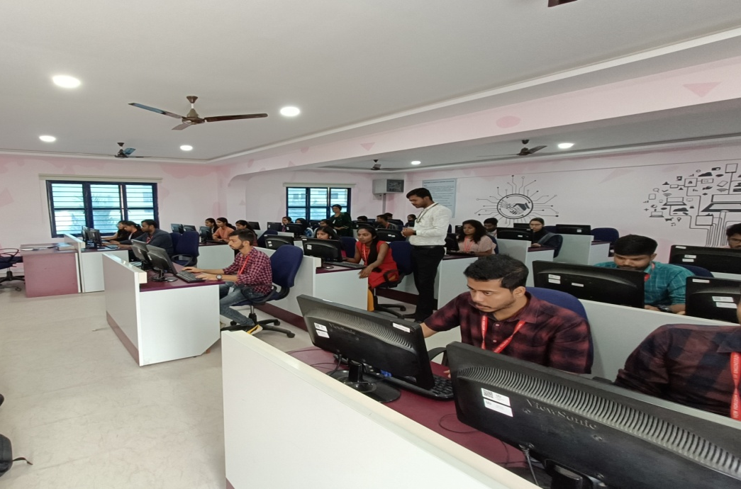
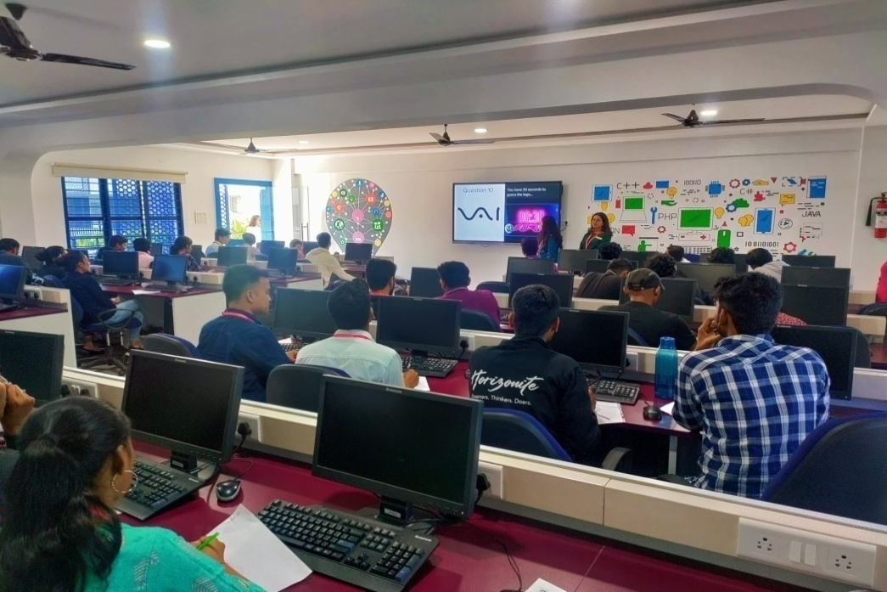
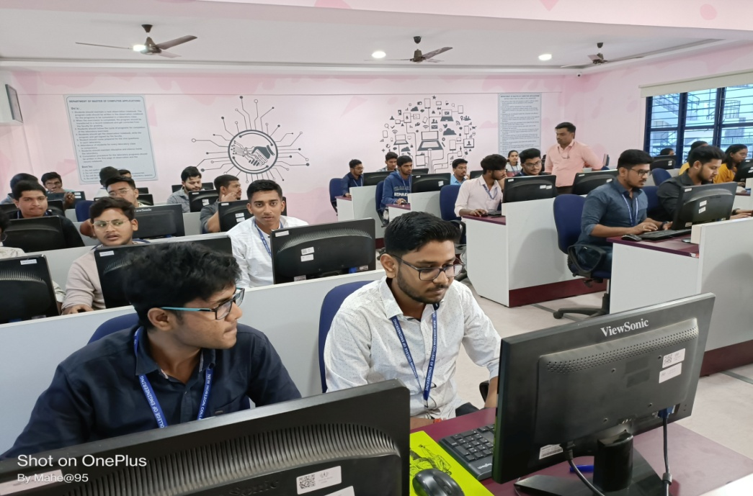
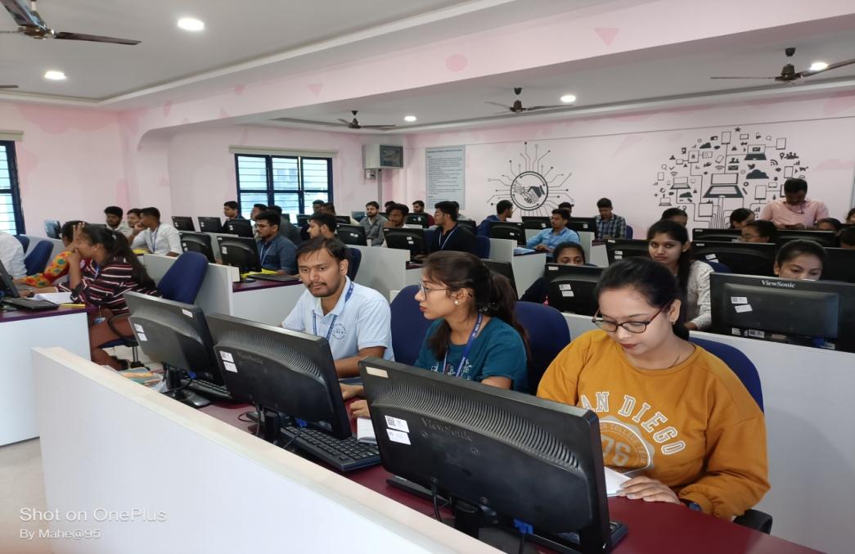
MCA LABS

Slide 19
STUDENT MENTORING & OTHER KEY DIFFERENTIATORS
Department of Master of Computer Applications (MCA)
Intensive Academic Mentoring
Life Skills Training for effective communications
Remedial classes for Slow learners
Aptitude and Life Skills Training
Domain specialized training
Industry-Oriented Electives
Industry-Internship Projects (mandatory)
Placement Training & Assistance
Alumni Interaction for Innovation-driven projects
Expert talk on new trends
Motivational session on innovation / incubation and entrepreneurship skills

Slide 20

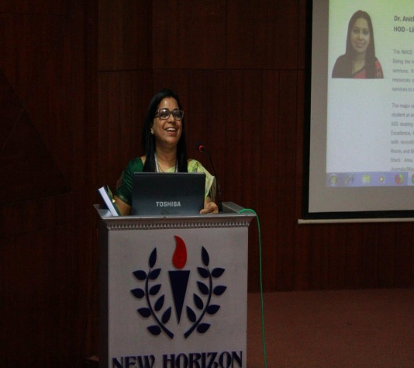
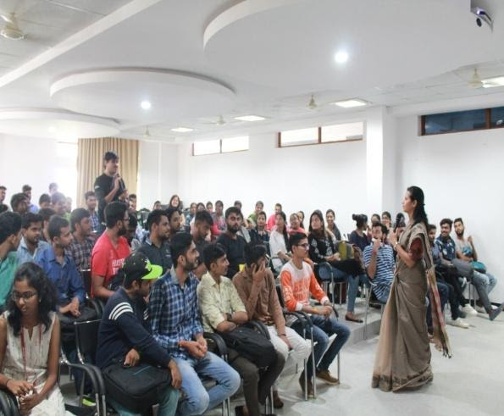
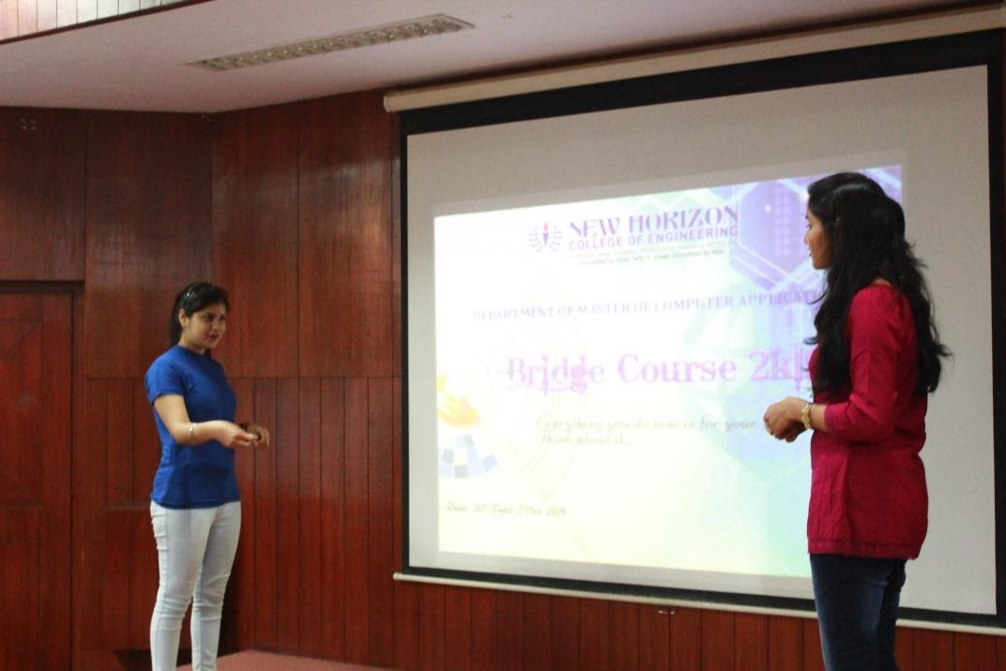
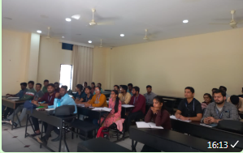
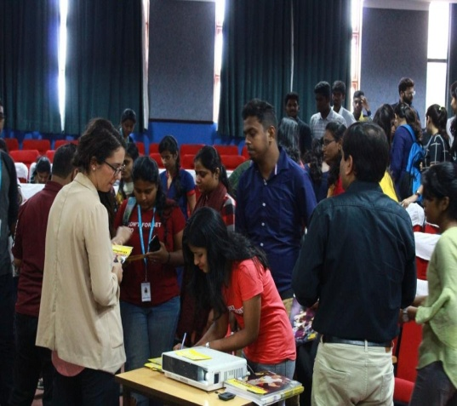
Department of Master of Computer Applications (MCA)
Bridge Course

Slide 21
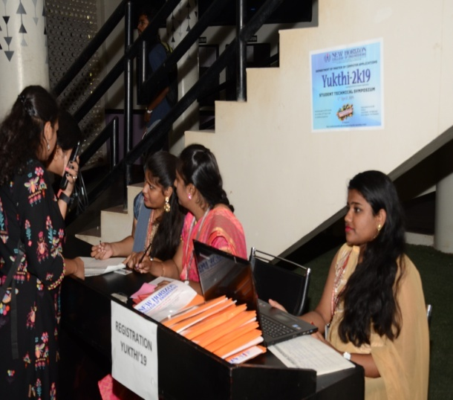
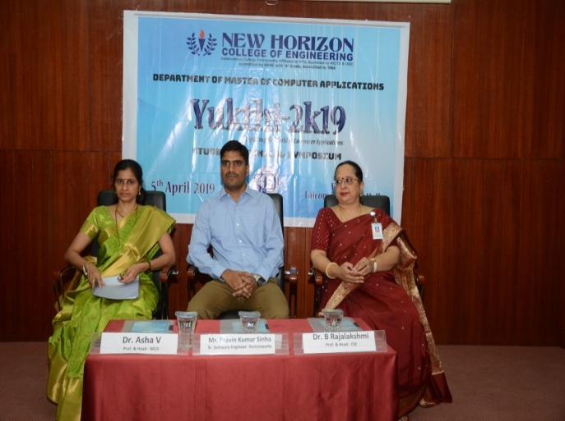
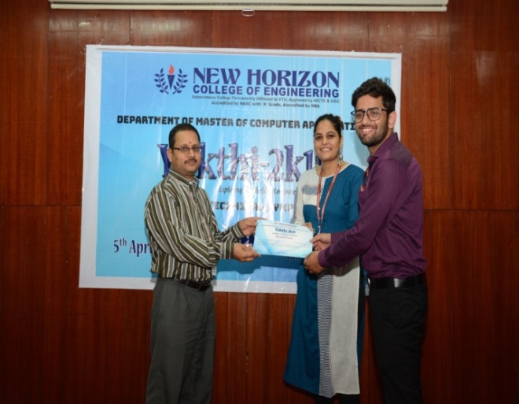
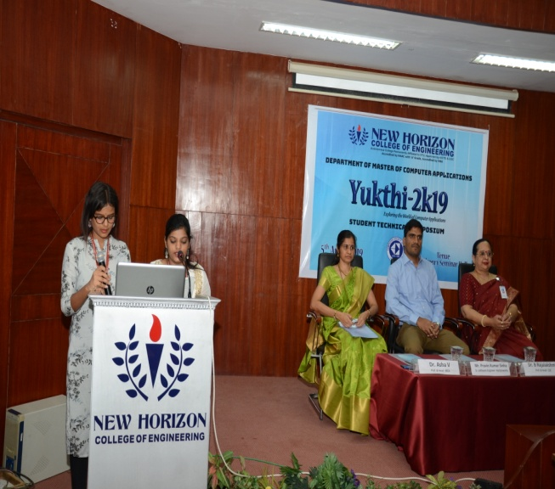
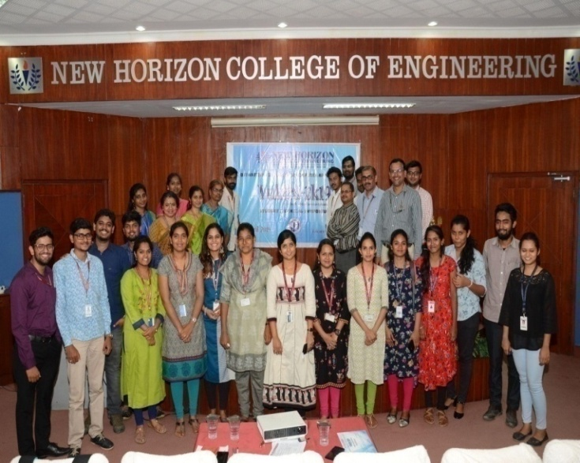
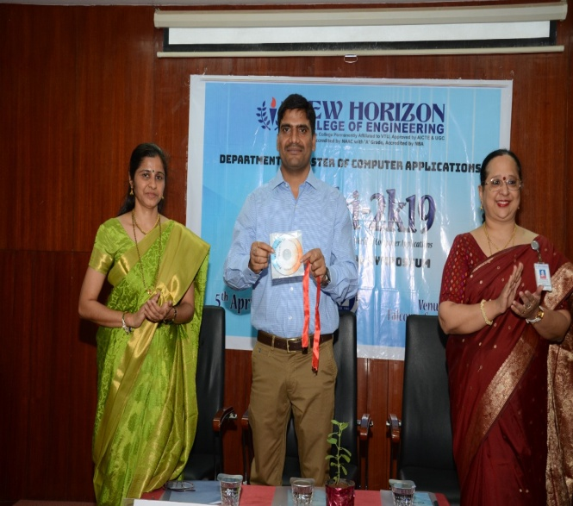
Department of Master of Computer Applications (MCA)
Symposium-Yukthi

Slide 22
CO-CURRICULAR ACTIVITIES & EXTRA-CURRICULAR ACTIVITIES
Department of Master of Computer Applications (MCA)
Student Symposium
Conferences
Project Exhibitions
Hackathon
Sports activities
Cultural activities
Inter Collegiate fest – SARGAM
Inter Departmental Tech fests

Slide 23
PLACEMENT TRAINING
Department of Master of Computer Applications (MCA)
Training Programs that are conducted regularly
Python, C and C++
Java Enterprise Architecture
Microsoft .NET Programming
Selenium – Testing Tools
Android Programming
Big Data Analytics – HP Vertica
Machine Learning and Data Science using Python
Cyber Security & Cyber Law
Cloud Computing , Internet of Things

Slide 24
Department of Master of Computer Applications (MCA)
SPECIAL FEATURES
Department News Letter – Rapid share to improve student’s technical writing skills.
Department Magazine to explore creativity
Yukthi – Annual technical student symposium
Journal to publish Intellectual ideas / Patents
Exhibitions to demonstrate software development / analytical skills
Industrial Visits

Slide 25
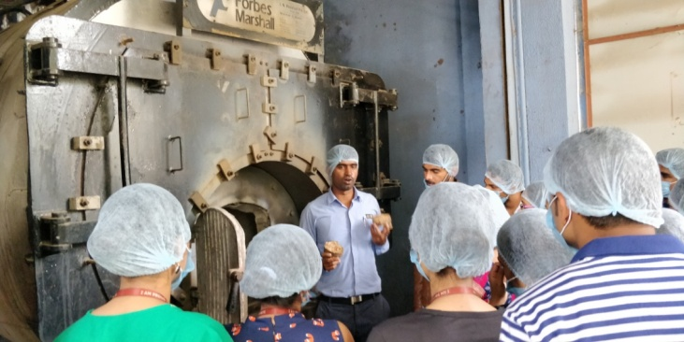
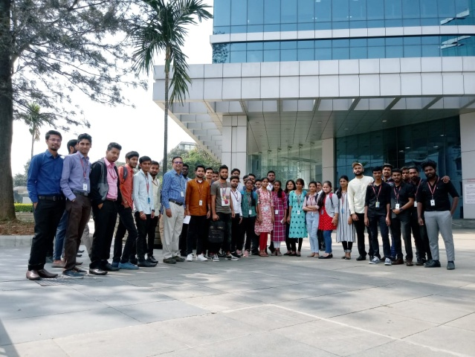
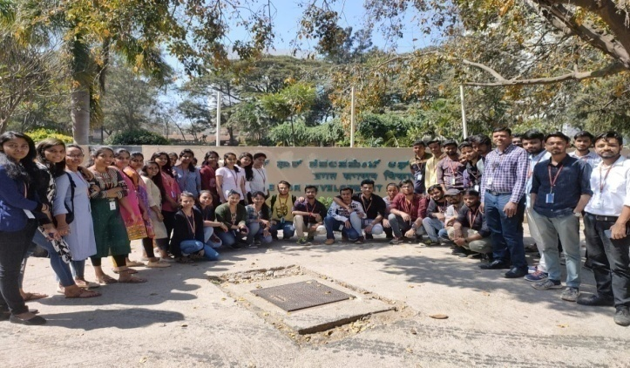
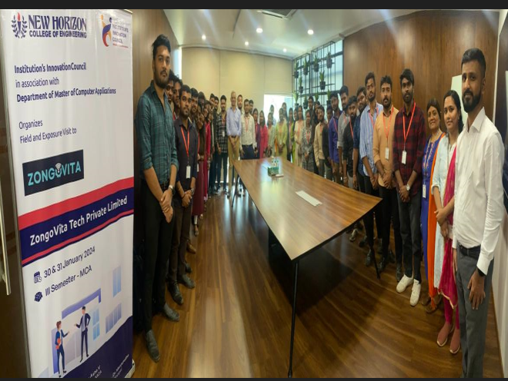
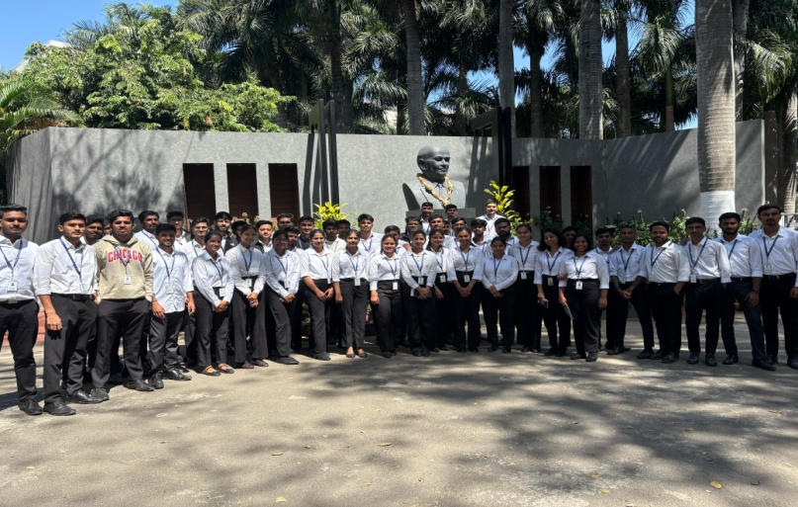
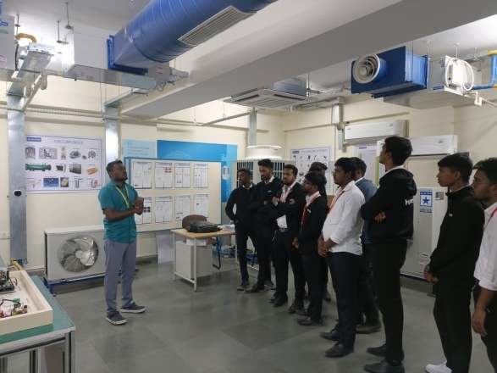
Department of Master of Computer Applications (MCA)
Industrial Visit
ISKCON
IBM
CDAC
ZongoVita
IDEA LAB
ISRO

Slide 26
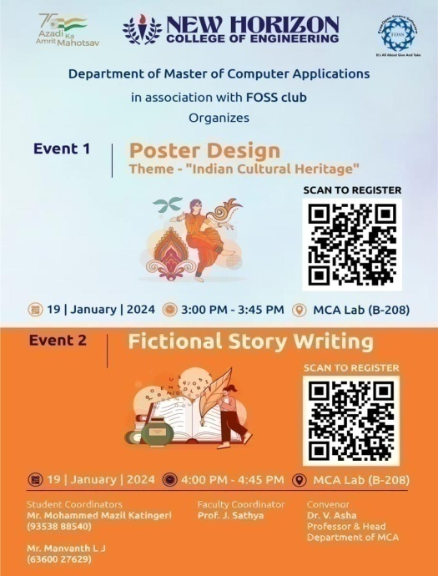
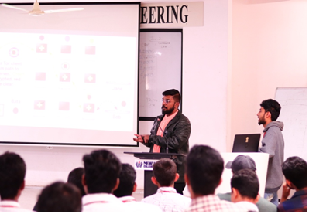
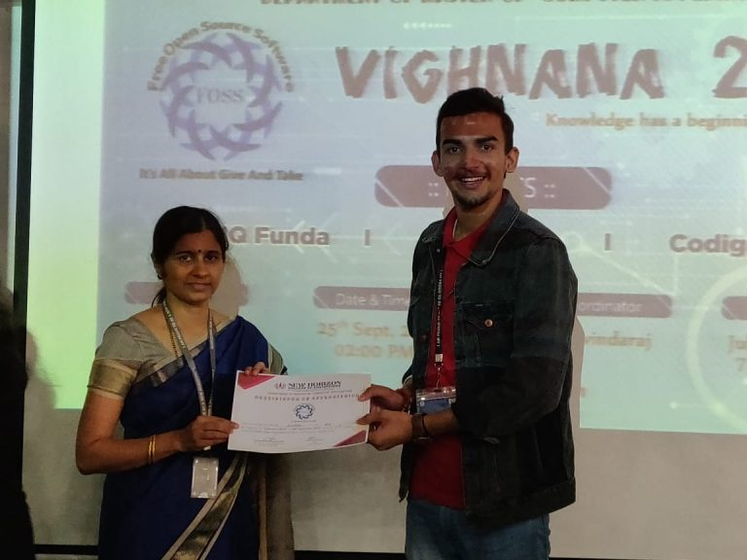
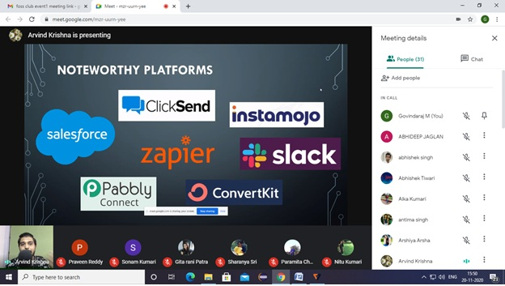
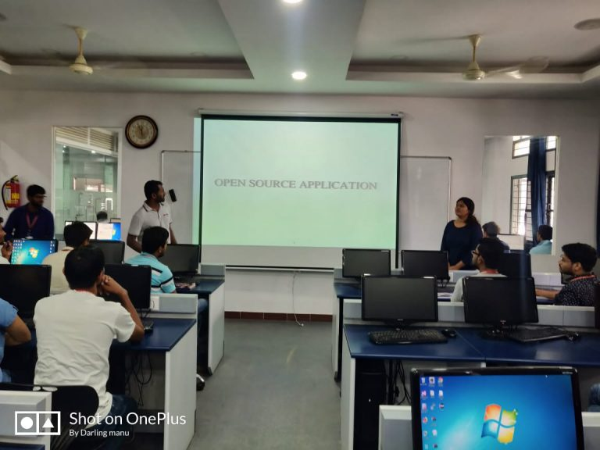
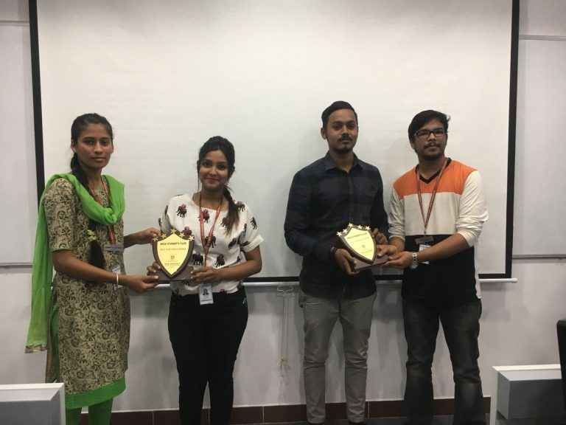
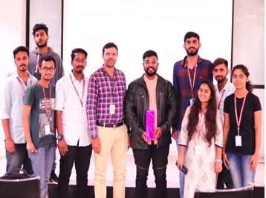
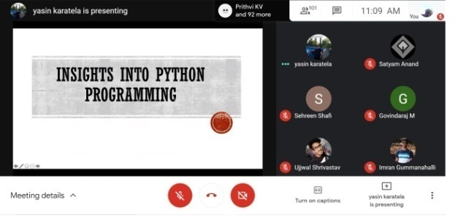
Department of Master of Computer Applications (MCA)
Department Club - FOSS

Slide 27
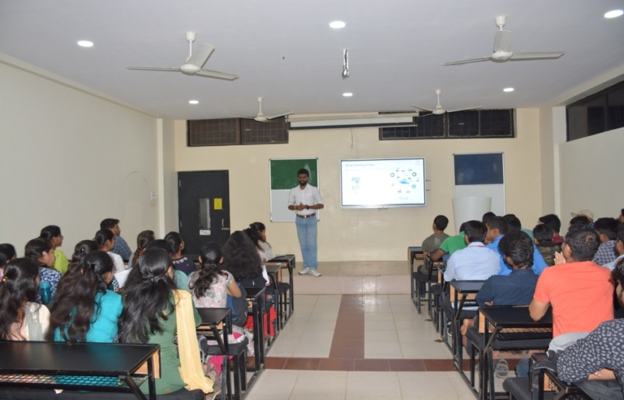
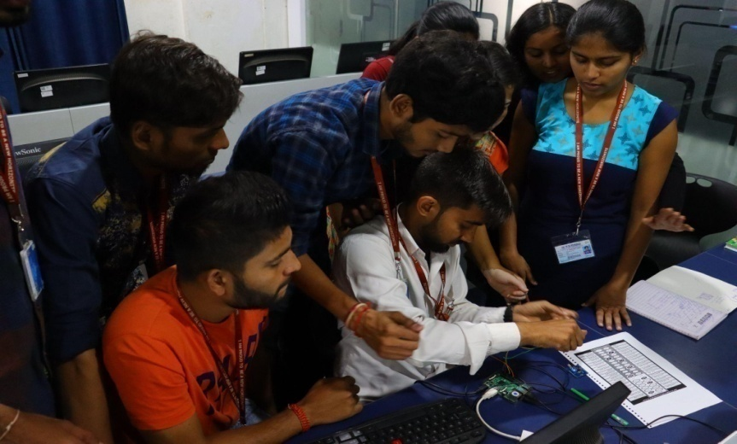
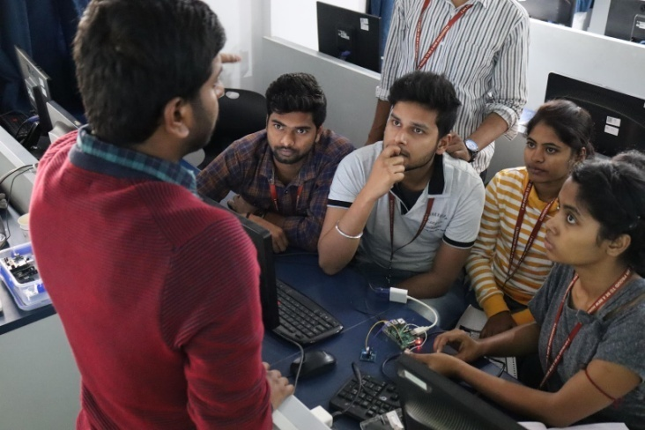
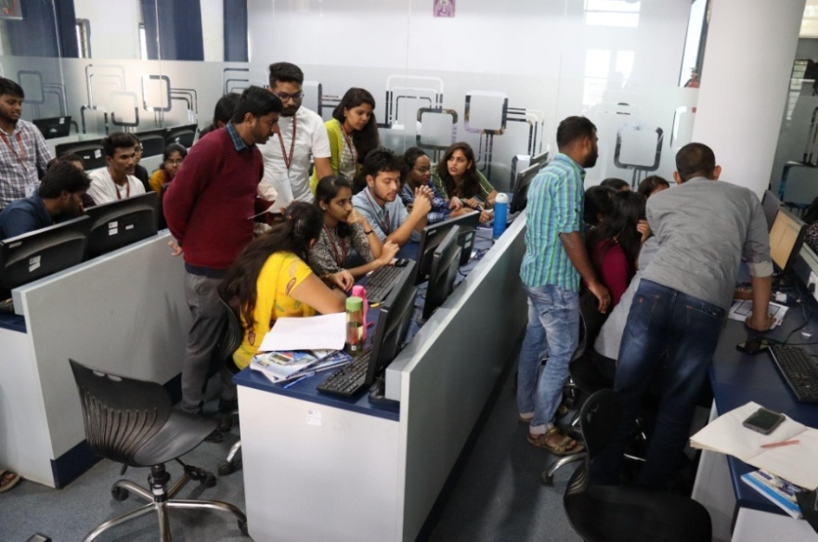
Department of Master of Computer Applications (MCA)
Workshops

Slide 28
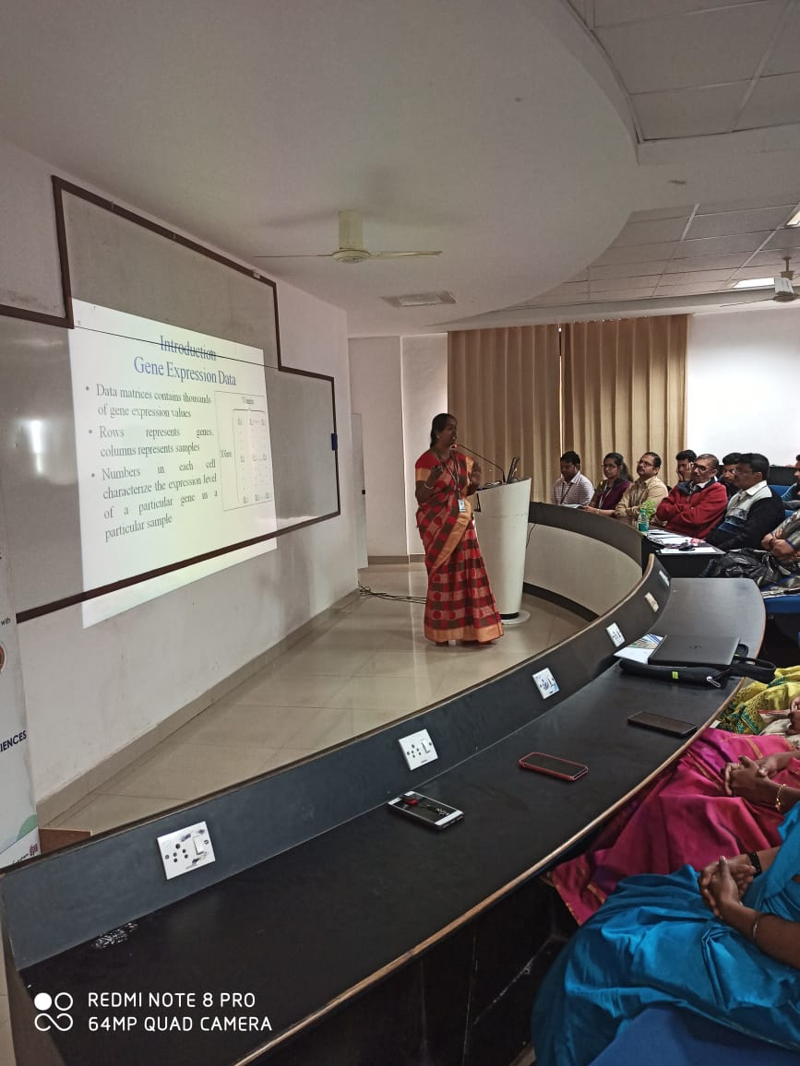
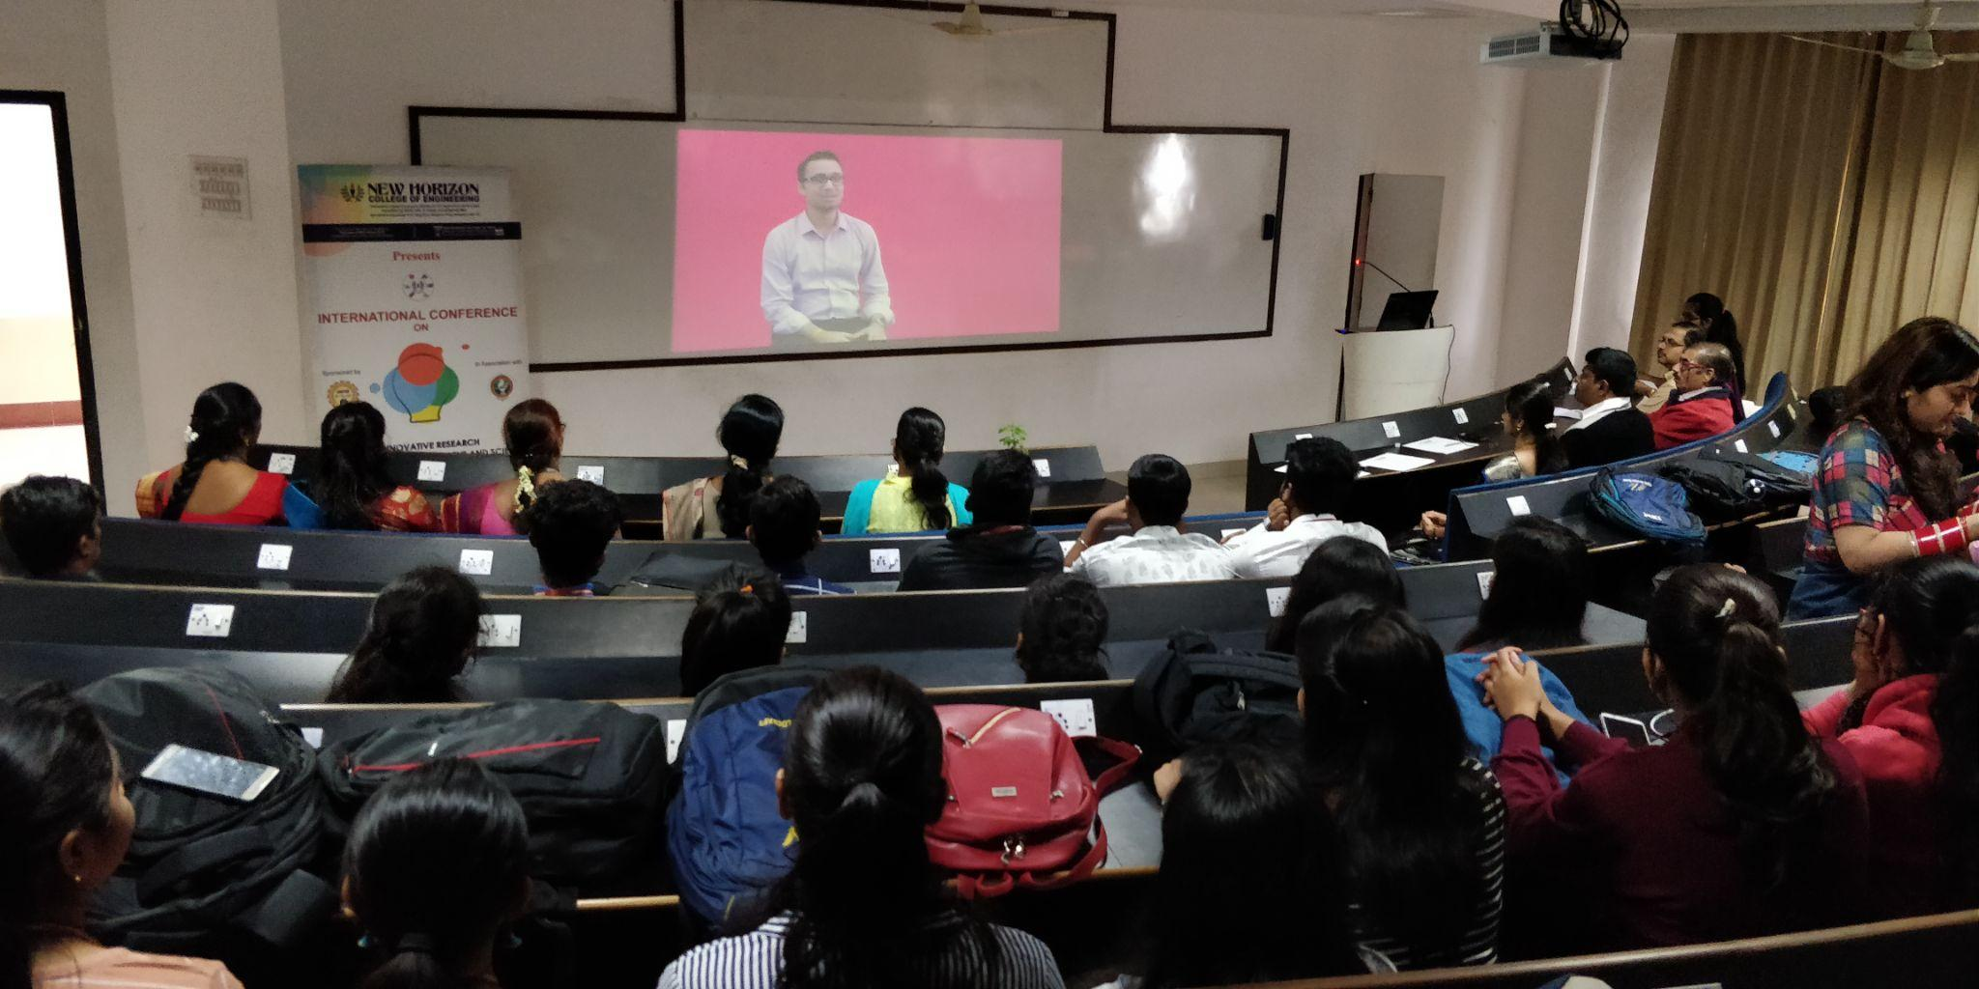
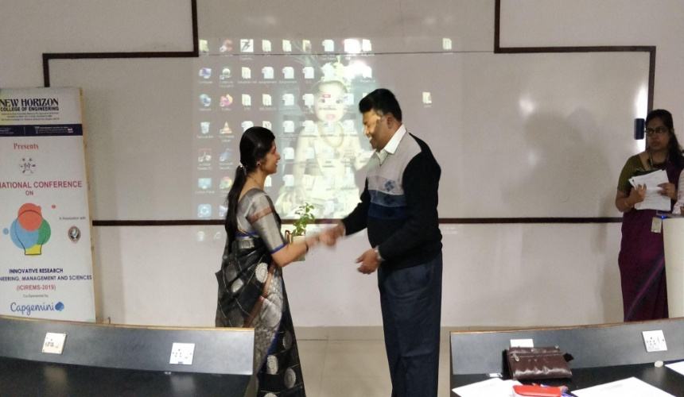
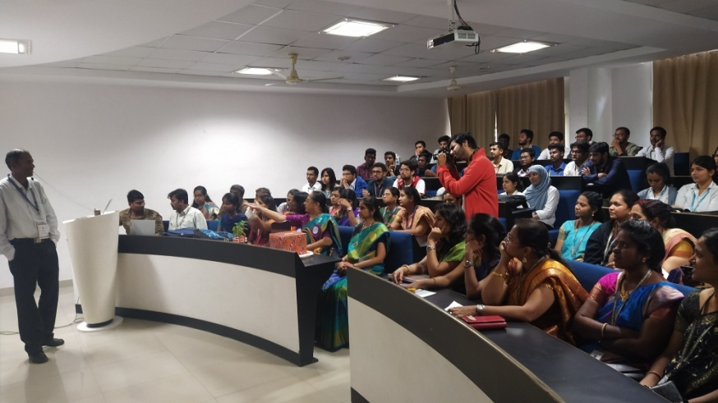
Department of Master of Computer Applications (MCA)
International Conference

Slide 29
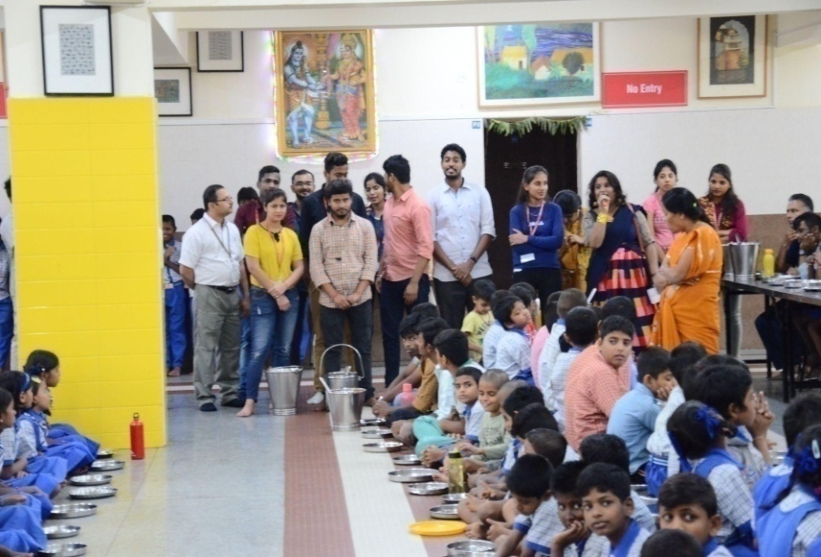
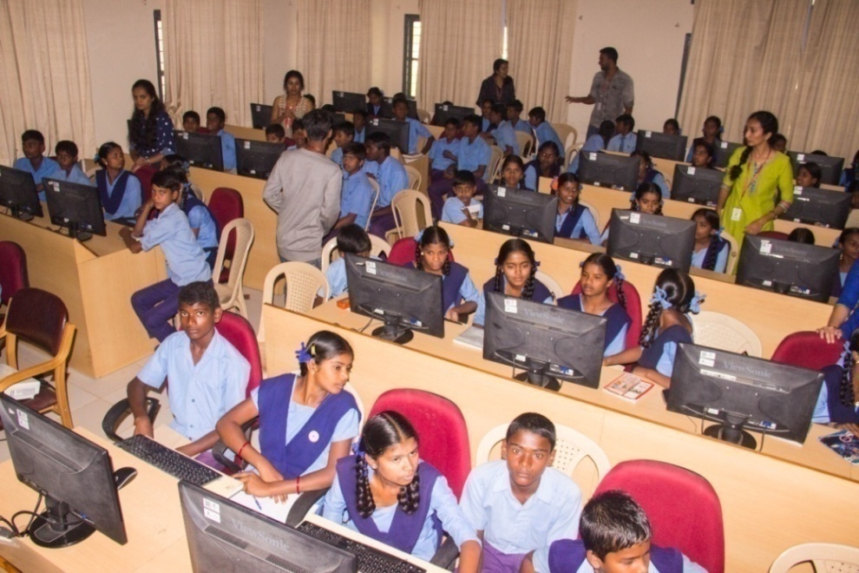
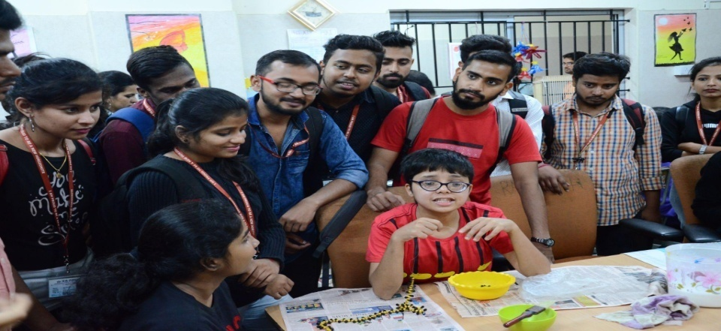
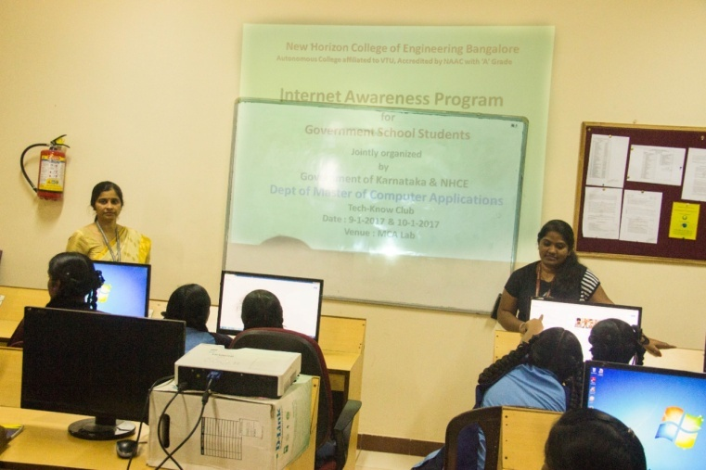
Department of Master of Computer Applications (MCA)
Extension Activity

Slide 30
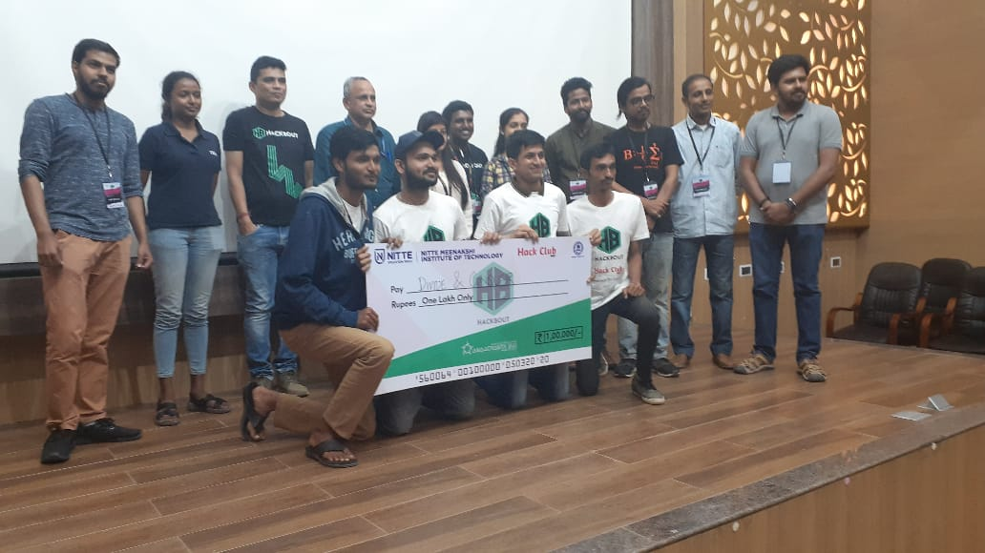
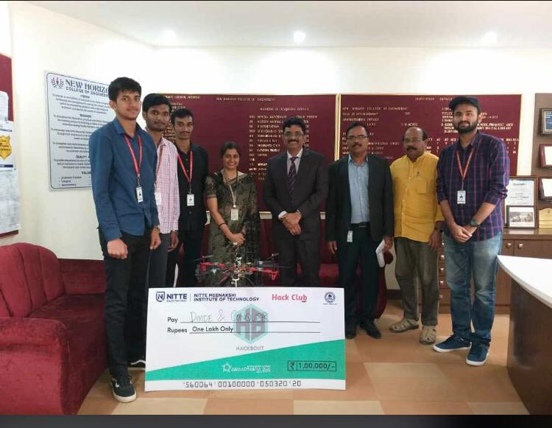
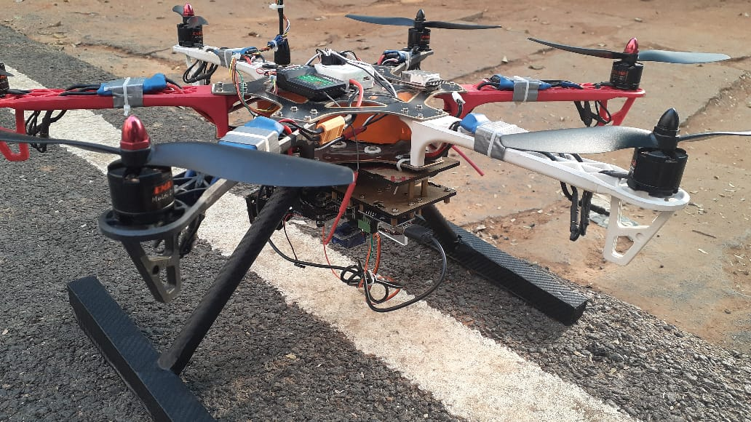
Department of Master of Computer Applications (MCA)
Hackathon

Slide 31
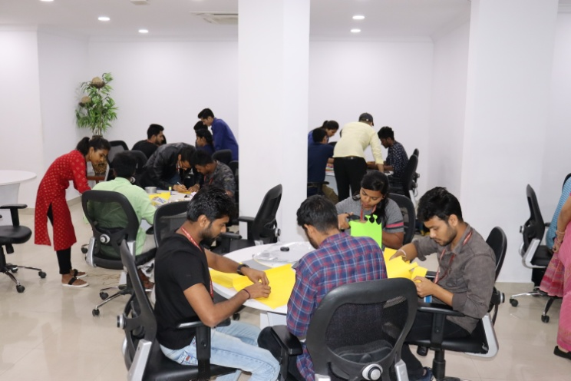
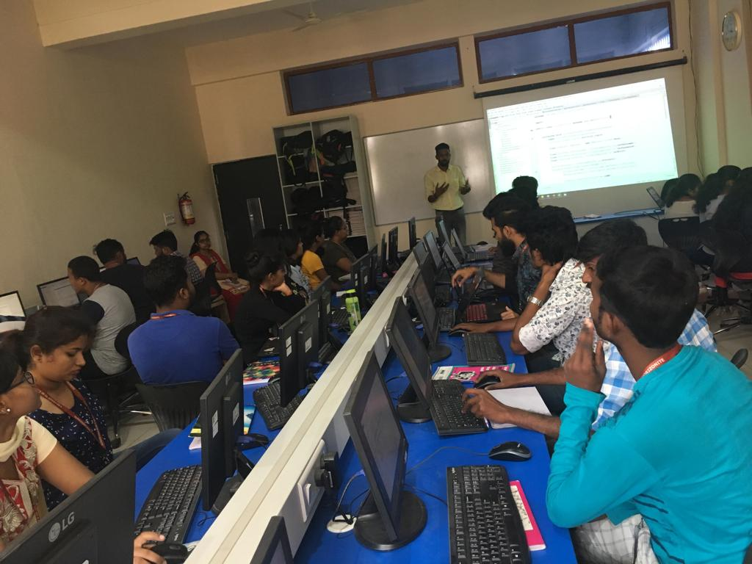
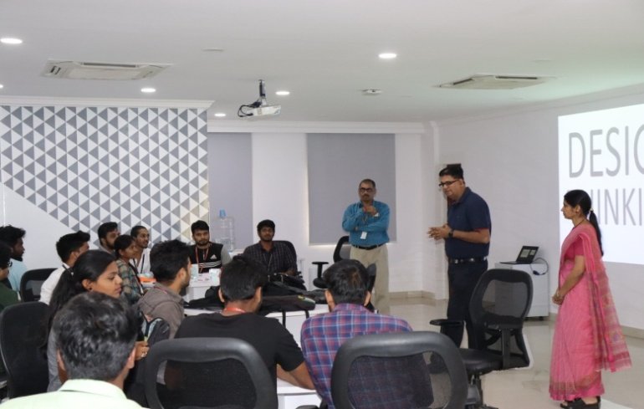
Department of Master of Computer Applications (MCA)
Activity Based Learning
Mobile Application Development
Design Thinking Workshop -Sponsored by SAP

Slide 32



Department of Master of Computer Applications (MCA)
Coding Contest

Slide 33



Department of Master of Computer Applications (MCA)
Professional Society Activities
(Computer Society of India)

Slide 34
RESEARCH FUNDS & PROPOSALS
Department of Master of Computer Applications (MCA)
MCA Department received funds & grants from various State & Central Government agencies such as:
AICTE - Received a grant of 3.18 lakhs for conducting FDP in 2019
VGST - Received a grant of 2 lakhs for conducting FDP in 2018
CSIR – Received 25,000 and 30,000 to conduct Workshop and Conference in the year 2010 and 2011

Slide 35
FUNDED STUDENTS PROJECT
Department of Master of Computer Applications (MCA)
Sl. No. | Achievement(s) | # of Projects | Amount Sanctioned
01 | Students Projects funded under KSCST SPP 45th Series | 02 | 13,000
02 | Students Projects funded under KSCST SPP 46th Series | 04 | 18,000
03 | Students Projects funded under KSCST SPP 47th Series | 06 | 25,500

Slide 36
Department of Master of Computer Applications (MCA)
SCOPUS INDEXED PUBLICATIONS
Sl. No | Achievement(s) | Details
1 | Scopus Indexed Student Papers Publication – AY 2021-22 | 8
2 | Scopus Indexed Student Papers Publication – AY 2022-23 | 34
3 | Scopus Indexed Student Papers Publication – AY 2023-24 | 51

Slide 37
CONSOLIDATED LIST OF PLACEMENTS
Department of Master of Computer Applications (MCA)
Year | Total No. of Final Year Students | Total No. of Students eligible | Total No. of Students placed | Total No. of Companies visited
2018-19 | 110 | 33 | 32 | 24
2019-20 | 122 | 50 | 44 | 38
2020-21 | 106 | 42 | 38 | 16
2021-22 | 207 | 207 | 165 | 27
2022-23 | 119 | 113 | 76 | 18
2023-24 | 119 | 92 | 52 | 36
2024-25 | 120 | 175 | 43 | 30

Slide 38
Department of Master of Computer Applications (MCA)
TRAINING AND PLACEMENT
Focuses on
Problem Solving Skills,
Creative Thinking,
Communication and behavioral skills,
Technical and Domain skills.

Slide 39
Department of Master of Computer Applications (MCA)
List of MCA Placed Students- 2024 Batch
Sl. No. | Company | Package | No. of Offers
1 | NOKIA | 360000 | 4
2 | FINTELLIX | 550000 | 1
3 | UST GLOBAL | 420000 | 1
4 | EPSILON | 500000 | 1
5 | SPERIDIAN | 350000 | 1
6 | CUBIC LOGICS | 650000 | 1
7 | MELTWATER | 700000 | 3
8 | INCADEA | 450000 | 1

Slide 40
Department of MCA
List of MCA Placed Students- 2025 Batch
Sl. No. | Company | Package | No. of Offers
1 | AI PALETTE | 400000 | 2
2 | LG SOFT | 390000 | 1
3 | NOKIA | 360000 | 2
4 | INFOSYS | 360000 | 5
5 | CUBIC LOGICS | 450000 | 3
6 | CONNEQTION GROUP | 600000 | 1
7 | CAPGEMINI | 450000 | 12
8 | ZEPTO | 450000 | 2
9 | LG SOFT | 392000 | 3
10 | LTI MINDTREE | 450000 | 5
11 | INTELLIPAAT | 500000 | 1
12 | INCADEA | 450000 | 1
13 | KRIYAFIT | 600000 | 2
14 | ZEPTO | 500000 | 5
15 | SPEKTRA SYSTEMS | 500000 | 1
16 | VISIONET | 400000 | 2

Slide 41




THANK YOU
For more information please contact
Phone: 080-66297777
Email: admissionsnhce@newhorizonindia.edu
Website: www.newhorizonindia.edu
Follow us on:

